Slide 1
Predicting House Price using
ML Models
Suniksha Gupta
Data Science Capstone Project

Slide 2
Abstract
Built a predictive model for house prices using a real-estate dataset containing key property, location, and structural features.
Performed comprehensive data cleaning, feature engineering, and exploratory data analysis to understand price-driving factors.
Evaluated multiple regression algorithms and selected the best-performing model based on accuracy, error metrics, and generalization capability.
Final model delivers reliable price predictions and provides insights into the most influential features affecting housing market trends.

Slide 3
Need for Project
Buying or selling a house involves big money, so accurate price estimates are important.
Housing prices change due to many factors that are hard to judge manually.
Would enable user to search home as per the budget.
Machine learning helps make fair, data-based predictions.
A good prediction model supports better planning and decision-making in real estate.

Slide 4
Proposed System
Collect housing data including features like location, BHK, floor, total area, bathrooms, and amenities.
Perform data cleaning: handle missing values, remove duplicates, and correct inconsistent entries.
Encode categorical features (like location and society) into numerical values for modeling.
Conduct exploratory data analysis to understand feature distributions, correlations, and outliers.
Apply feature engineering to create new meaningful variables or transform skewed features (e.g., log-transforming prices).
Split the dataset into training and testing sets for model evaluation.
Train multiple regression models (Linear Regression, Random Forest, Gradient Boosting, etc.) and compare performance metrics.
Select the best-performing model and fine-tune hyperparameters for improved accuracy.
Use the final model to predict house prices and identify key factors influencing price.

Slide 5
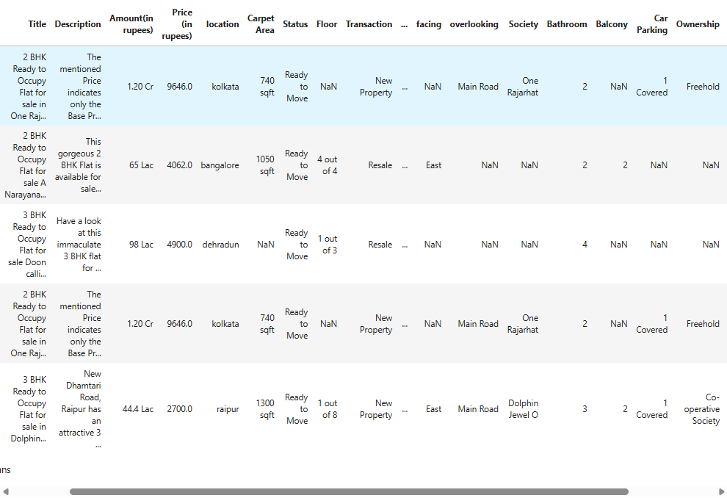
Snapshot of Data
The following snapshot shows the head of the data taken from Dataset used in House Price Prediction

Slide 6
Dataset Description
Dataset Size: 187531 x 21 (Link to the data: https://www.kaggle.com/datasets/juhibhojani/house-price)
Following are the parameters in dataset for house price prediction:
Index
Title
Description
Amount(in rupees)
Price (in rupees)
location
Carpet Area
Status
Floor
Transaction
Furnishing
facing
overlooking
Society
Bathroom
Balcony
Car Parking
Ownership
Super Area
Dimensions
Plot Area

Slide 7
Pipeline
Data Collection
Data Cleaning and Pre-processing
Exploratory Data Analysis (EDA)
Feature Selection/ Feature Engineering
Train-Test Split
Model Training
Model Evaluation
Final Model Selection

Slide 8


Data Cleaning and Pre-processing
The main aim of Data Cleaning is to identify and remove errors and duplicate data, in order to create a reliable dataset.
The process of data cleaning is done by using a very famous library pandas.
Initially those columns/features and values (non-relevant) are dropped from our dataset which showed only null values in the entire column.
The rows having a null value in any columns are dropped from our dataset.
The columns having character as well as integer values are converted into integer values only.
Example:
Many more data cleaning techniques are used to improve the quality of our dataset.
"2 BHK" → extracted numerical value 2
"1000 sqft" → extracted 1000 as numerical area

Slide 9
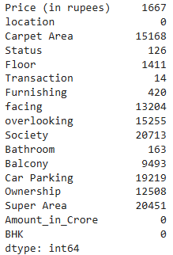
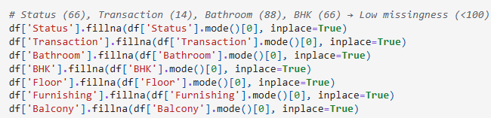
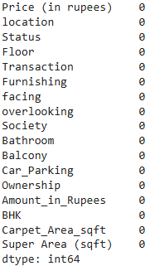
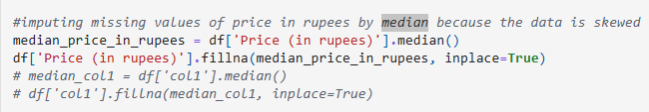
Data Cleaning and Pre-processing
Handling Missing Values- Used df.isnull().sum() to inspect missing data across all columns. Found missing entries in fields like Carpet Area, society, Super Area, balcony, and bathroom, Price (in rupees) and other columns too.

Slide 10
Data Cleaning and Pre-processing
Dropped rows with excessive missing values to maintain dataset quality.
Removed inconsistent entries- df[df['Amount(in rupees)'] != 'Call for Price’]
Processing ‘Price’ Columns (Very Important Step): Converting Lakhs and Crores to a common unit. Identified two currency units: Lakh (L) and Crore (Cr). Created a new normalized column Amount_in_Crore.
df['Amount_in_Crore'] = df.apply(lambda x: x['Value'] if ['Currency'] == 'Cr' else x['Value'] / 100, axis = 1)

Slide 11
Data Visualization and EDA (Exploratory data Analysis)
Exploratory Data Analysis (EDA) helps us understand the data before building any model.
It includes visualizing patterns, trends, correlations, and identifying outliers or unusual values.
EDA allows us to see which features influence house prices the most (location, size, bathrooms, etc.).
Visual charts like histograms, box plots, pair plots, and correlation heatmaps make it easier to interpret relationships in the dataset.

Slide 12
In the next few slides, I will show some of the important plots and relationships among data.

Slide 13
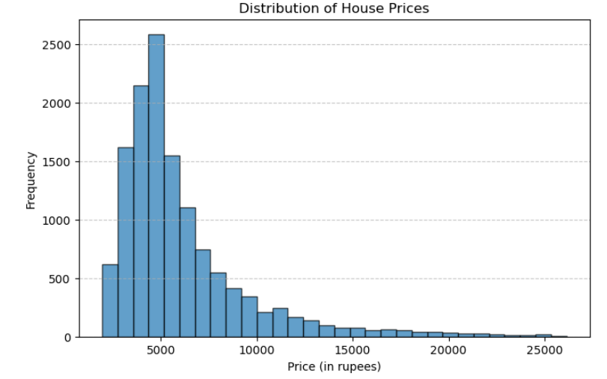
Data Visualization
Histogram of Target feature-right skewed

Slide 14
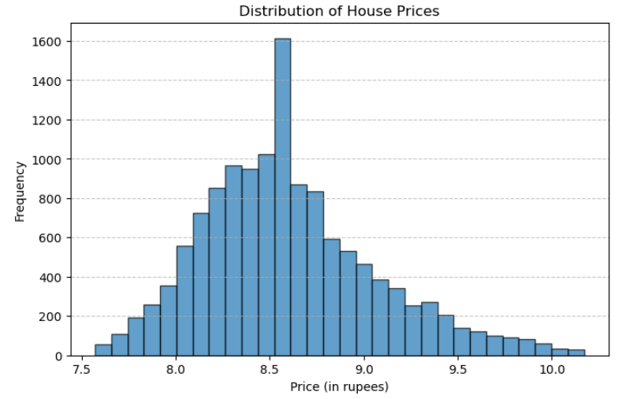
Data Visualization
Applied log transformation to the Price column to reduce right-skewness and achieve a more normalized and evenly distributed range of values

Slide 15
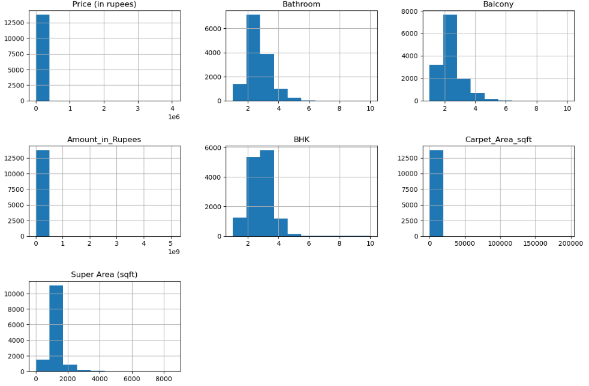
Data Visualization (Outlier Detection)
Histogram of all numerical feature, showing the outliers present in data

Slide 16
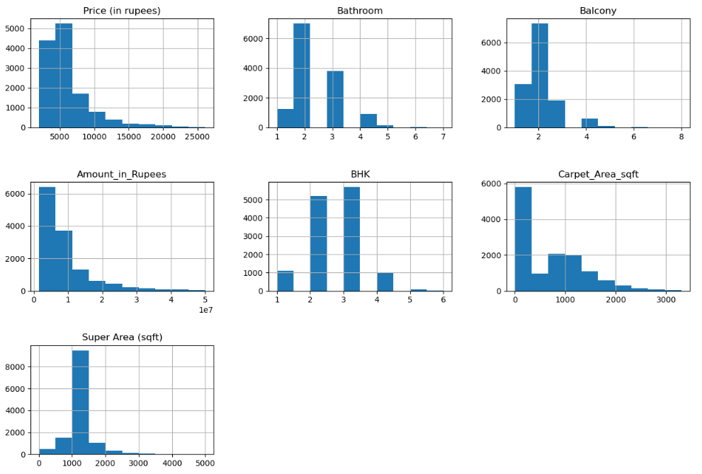
Data Visualization (Outlier Removal)
Histogram after removing outliers identified through careful examination of the distribution and feature behavior

Slide 17
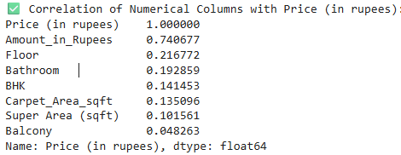
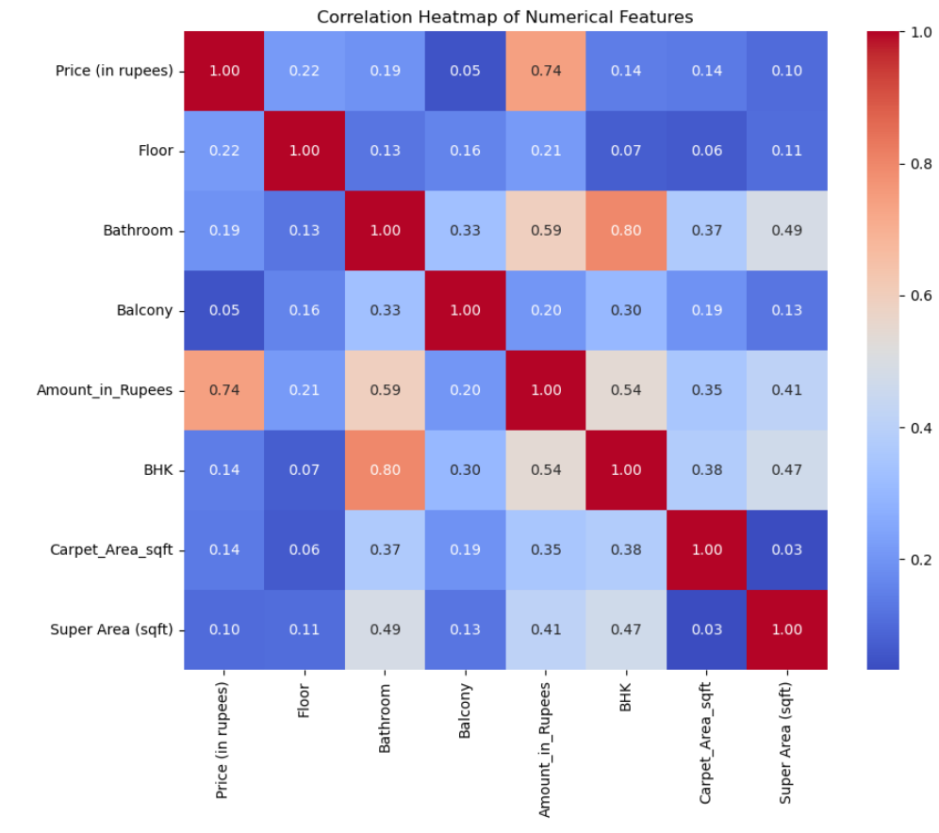
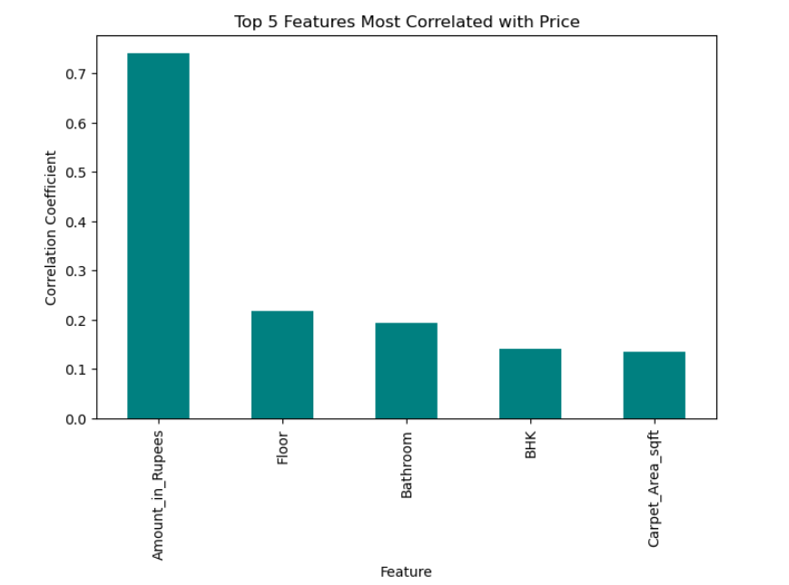
Data Visualization
Correlation of Numerical columns with Price (in rupees):

Slide 18
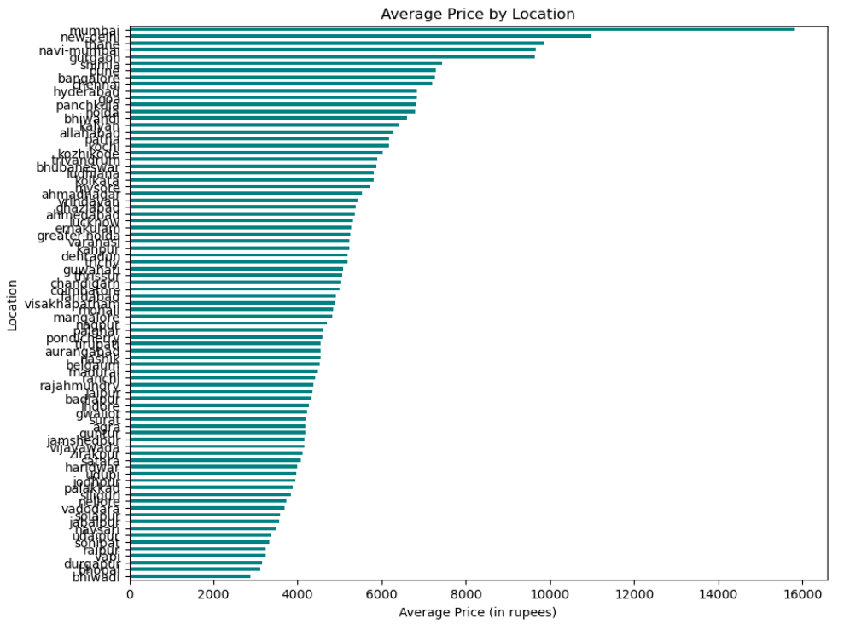
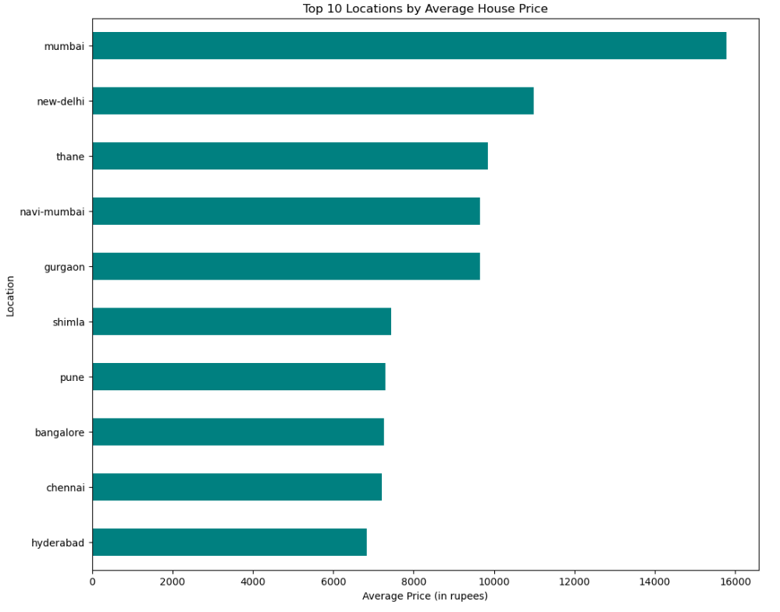
Data Visualization
Average Price by Location and top 10 location by average price

Slide 19
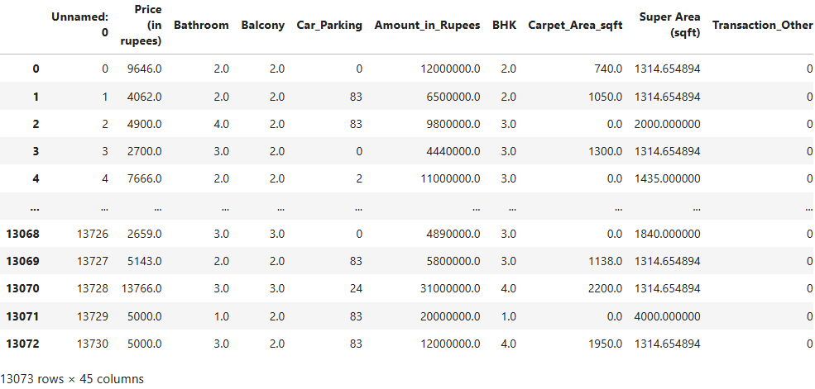
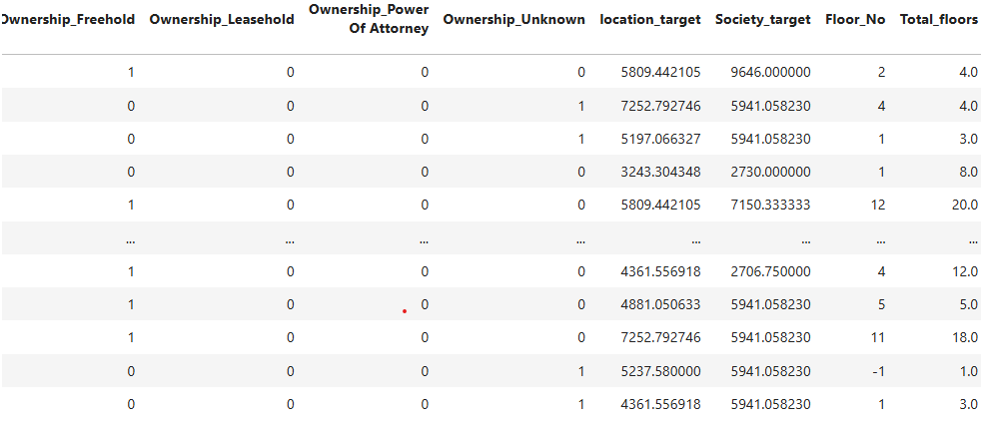
Dummy or indicator features for categorical variables
Data Visualization
This technique is used to convert the categorical variables into numeric values.
Out dataset contains some categorical variable which are: ‘location’, 'Status', 'Transaction', 'Furnishing', 'facing', 'overlooking', 'Ownership’, ‘Society’, ‘Floor’, ‘Car Parking’.
We have used one hot encoding and Label Encoding method to convert them as numeric values
As we can see the all the categorical columns have now been converted to numeric features only

Slide 20
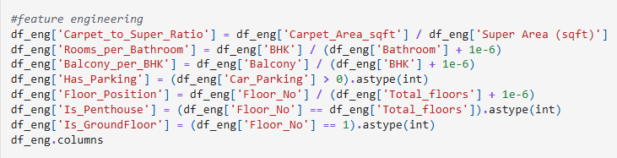
Feature Engineering
Feature engineering is the process of using domain knowledge to extract features from raw data via data mining techniques. These features can be used to improve the performance of machine learning algorithms. Feature engineering can be considered as applied machine learning itself.

Slide 21
Machine Learning Algorithm
We set the independent and target variables as X and Y respectively.
Split the dataset into training and testing set in 70:30 ratio.
Fitting the train set to multiple models (Linear Regression, Random Forest, Ridge Regression, Gradient Boosting and Ada Boost) and getting the score on test set.
Calculated the MSE (Mean Squared Error), MAE(Mean Absolute Error) and accuracy score (R-squared) and compared the same for each model.
Calculated the mean of Cross-Validation score for training and test set and compared the same for each model.
Lastly completed the modelling by applying Random Search and Grid Search for Hyperparameter tuning

Slide 22
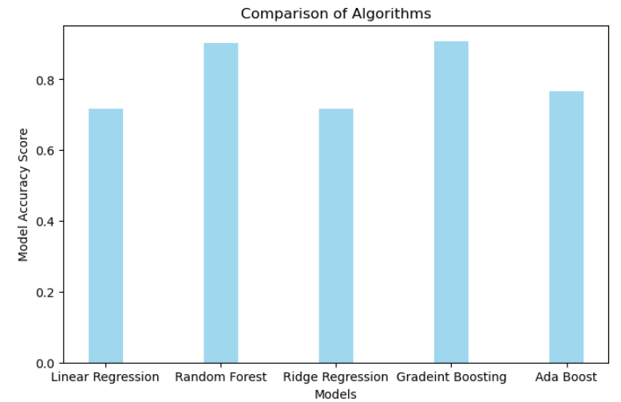
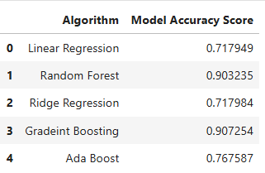
Machine Learning Algorithm
Comparison of Model Accuracy score for all five models
--Random Forest and Gradient Boosting showed highest accuracy of approx. 90%.

Slide 23
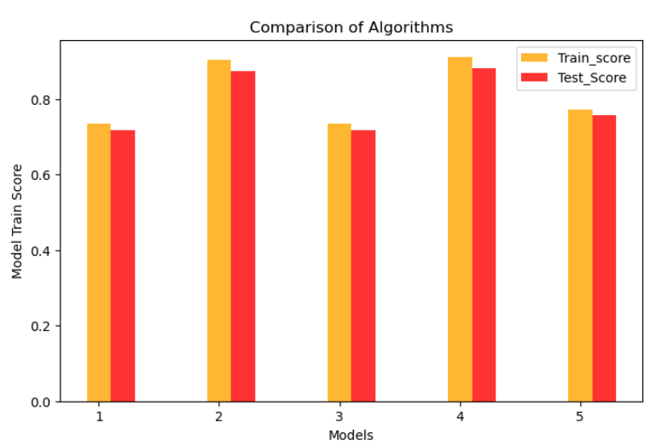
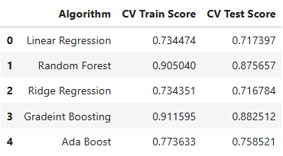
Machine Learning Algorithm
Comparison of Algorithms on their training and test cross validation mean.

Slide 24

Random Search Cross Validation
This is a techniques used to find the best parameters for our machine learning model.
Parameter tuning for Random Forest: Best parameters came out to be:
Model Metrics for Random forest after fitting the best parameters obtained from Random Search

Slide 25
Key Findings from the Project
1. Data & Market Insights
Housing prices were found to be heavily right-skewed, largely due to a small subset of luxury properties.
Both structural features (BHK, carpet area, bathrooms) and geographical advantages (location, society) strongly influence price.
2. Model Performance Insights
Linear models (Linear Regression, Ridge Regression) showed moderate accuracy (~0.718), struggling with non-linear interactions.
Ensemble models performed significantly better:
  Random Forest R²: 0.903
  Gradient Boosting R²: 0.907
Cross-validation showed low variance, indicating good generalization.
3. Final Tuned Model Results
After hyperparameter optimization, the tuned Random Forest model achieved:
  MAE: 0.0913, MSE: 0.0219, RMSE: 0.1480, R² Score: 0.8983
Metrics confirm high predictive accuracy, low error, and strong robustness across scales.

Slide 26
Conclusion
The project successfully built a reliable and accurate predictive model for housing price estimation.
Systematic steps including EDA, encoding, feature engineering, scaling, training, evaluation, and hyperparameter tuning led to a strong final model.
The optimized Random Forest model captures complex, non-linear patterns in real estate data and offers consistent, high-quality predictions.
This model provides a strong foundation for:
  Deployment in real estate applications
  Automated price estimation systems
  Decision support for real estate agents, buyers, and investors

